Slide 1

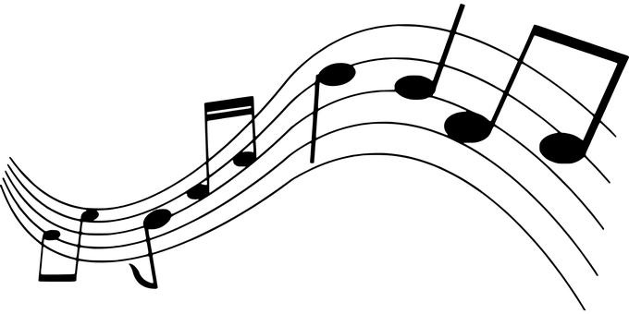
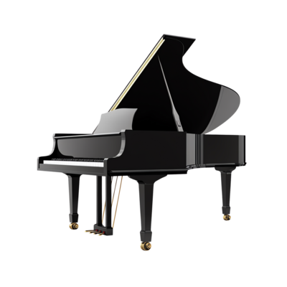
Music
Generation
A Transformer-Based Chord Generation Model
RYAN GHIMIRE & ANIKETH LUCHMAPURKAR

Slide 2
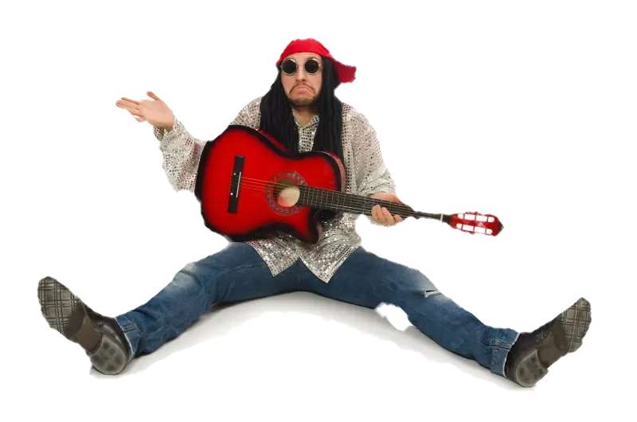
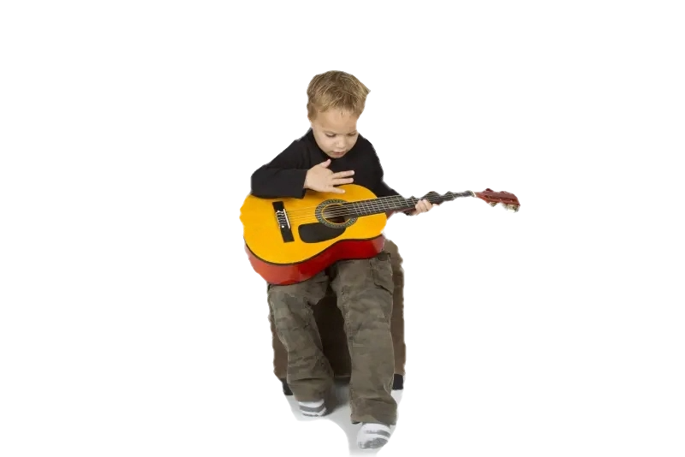
Problem
Melodies without chords/accompaniments
sound empty
Many struggle to compose accompaniments
Current models generate full songs
These models restrict, not foster, creativity

Slide 3
Related Work
Music generation began with statistical modeling to generate melodies (Conklin, 2003)
Transformer and Recurrent Neural Network (RNN) models
DeepBach,
RNN model focused solely on generating classical music pieces from scratch (Hadjeres et al., 2017).
These models have further evolved to generating:
Varied music styles (Mao et al., 2018)
Songs based on melodic feature input (Copet et al., 2024).
Google Magenta
Specialty in chord generation
Spotify CTRL working on AI tools for music creation assistance

Slide 4
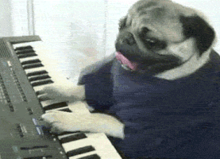
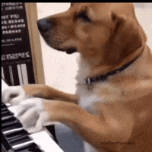
Solution
Model that generates chords for melodies
Predicts chord from melody fragment and past chords, ensuring…
Chord matches notes
Consistent chord progressions

Slide 5
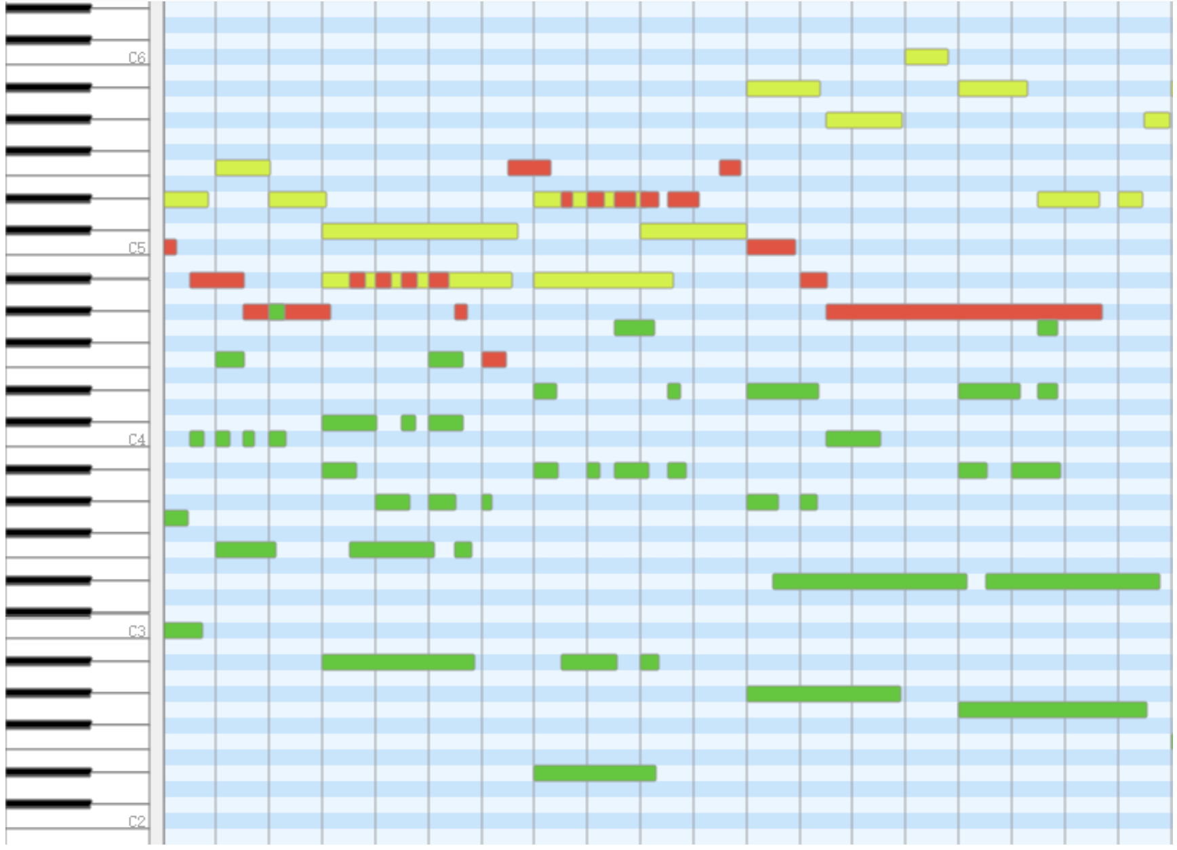
Dataset & Preprocessing
POP909 dataset: 909 pop melodies and accompaniments
Broke melody into fragments by associated chord
Constructed CSV
Each instance: <Key, Melody Sequence, Past N Chords, Chord>
Numericized “Past N Chords” (feature) and “Chord” (labels) with label encoder

Slide 6
The Model
Previous Chords
Melody Sequence Fragment
Split into sub-models:
Melody Sequence Sub-Model
Previous Chord Sub-Model
Model
Melody Sequence Submodel
Previous Chord Submodel
Generated Chord

Slide 7
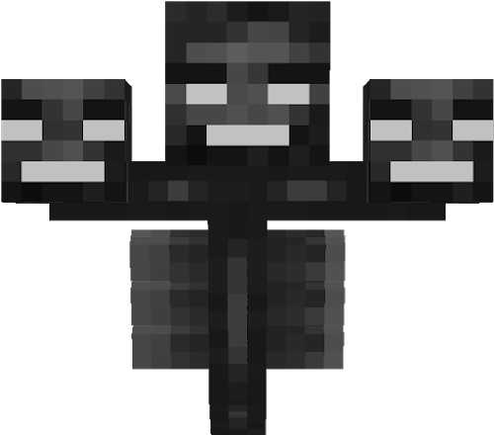
Melody Sub-Model
Input layer
Embedding layer
Lowers dimensionality to make it able to draw relationships between parts of input
Transformer Layer
Self-attention
Discovers what is important in melody
Develops correlations and relationships
Multi-head attention
Parallel runs of self-attention
Global Pooling Layer
Average into singular vector

Slide 8
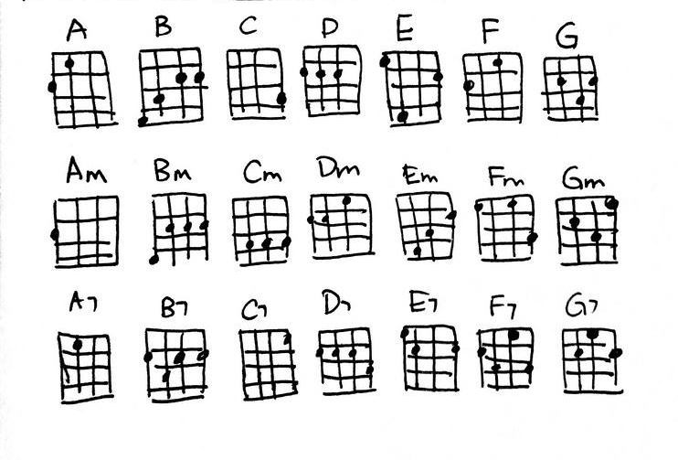
Previous Chord Sub-Model
Input Layer
Embedding Layer
Flatten Layer
Multidimensional Vector → 1D vector (flattening)
Dense Hidden Layer
Finds correlations/patterns in flattened data

Slide 9
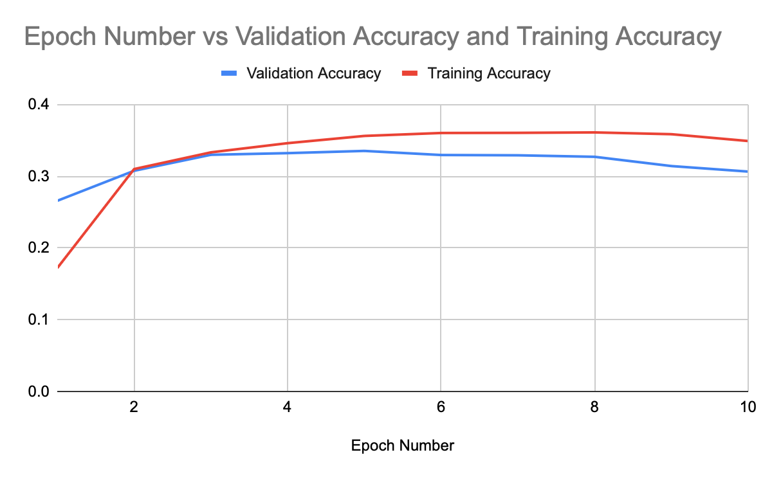
Results

Slide 10
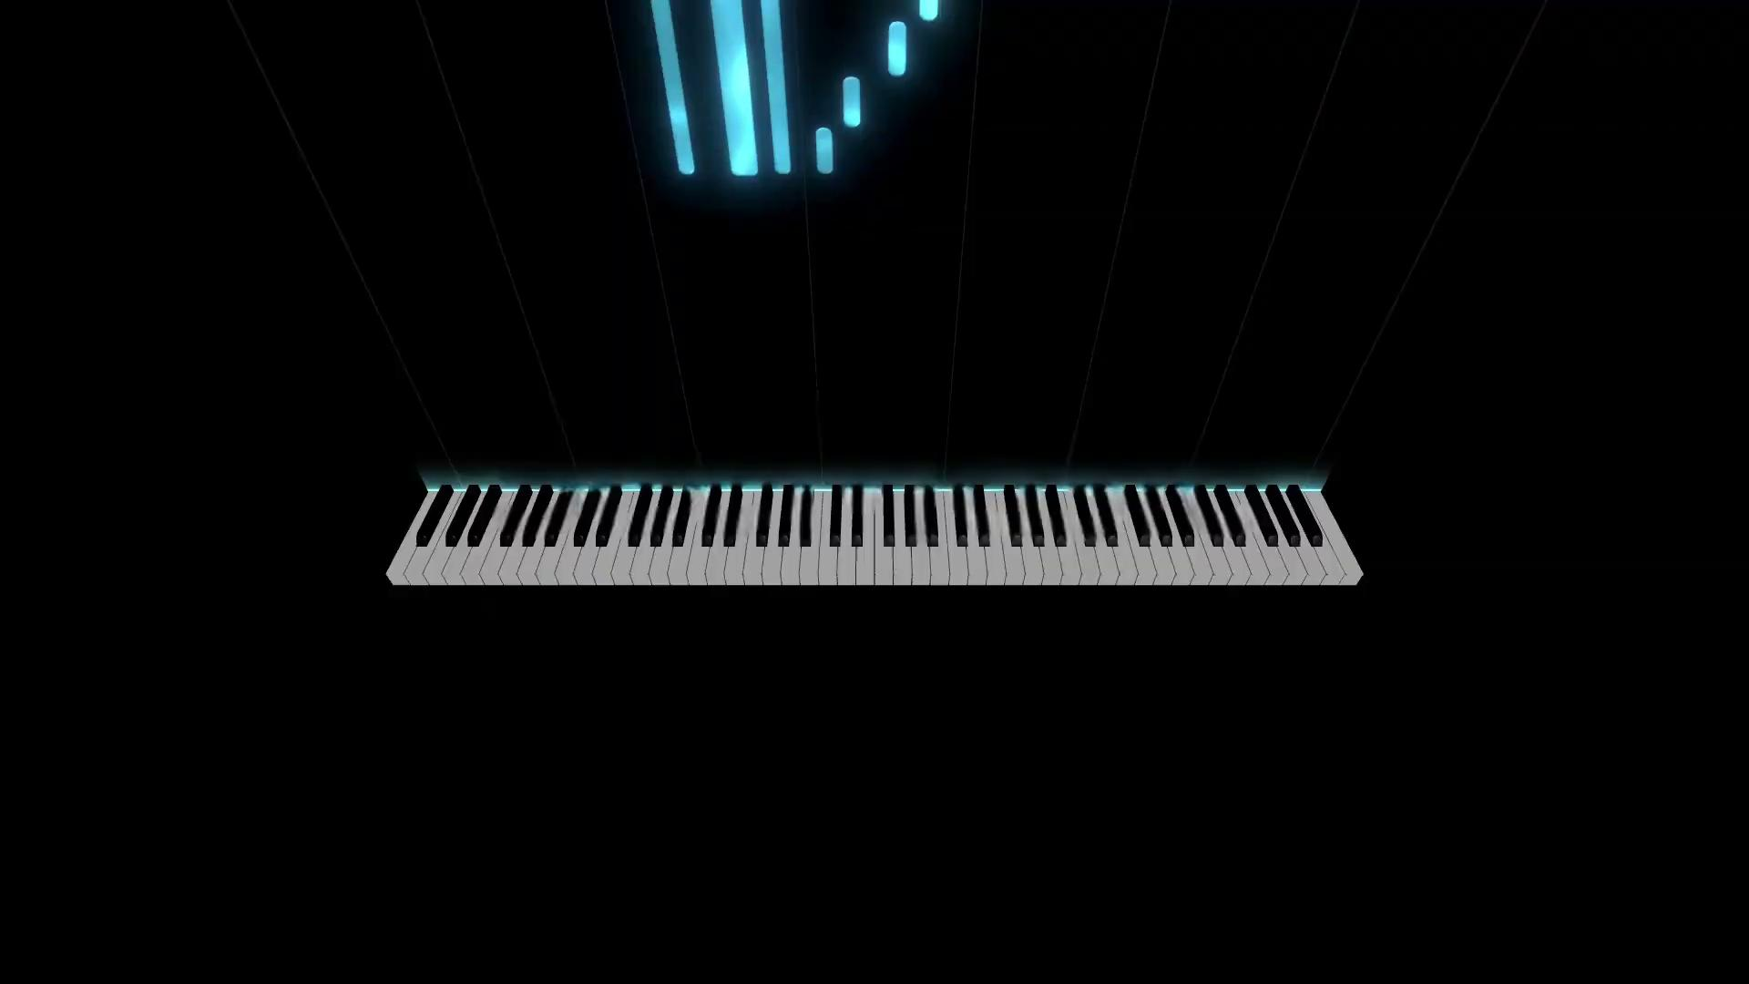
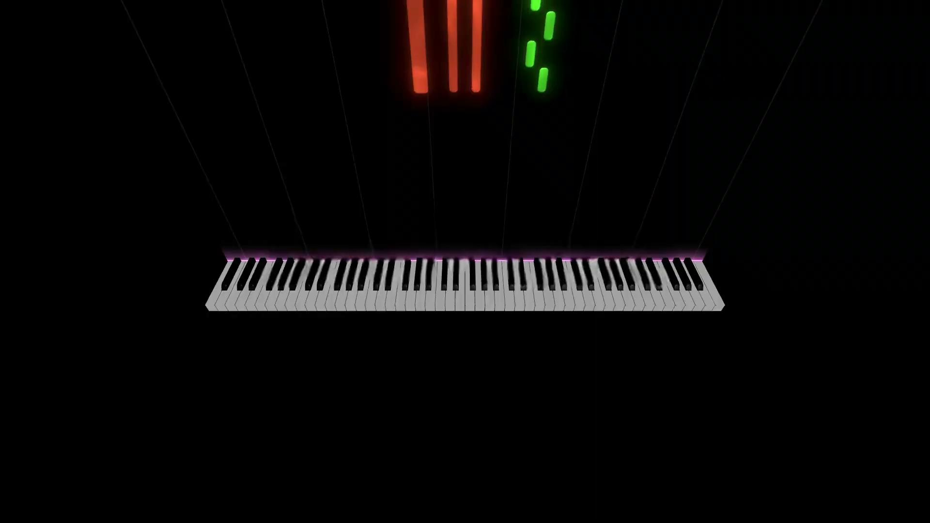
Results

Slide 11

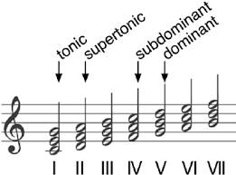
Conclusion
Model predicts harmonically fitting chords
Struggles with repetitive chord progressions
Needs better focus on musical structure
Future Improvements
Incorporate harmonic function data
Expand to tempo and dynamic variation

Slide 12

Thank You!
Any Questions?

